Slide 1
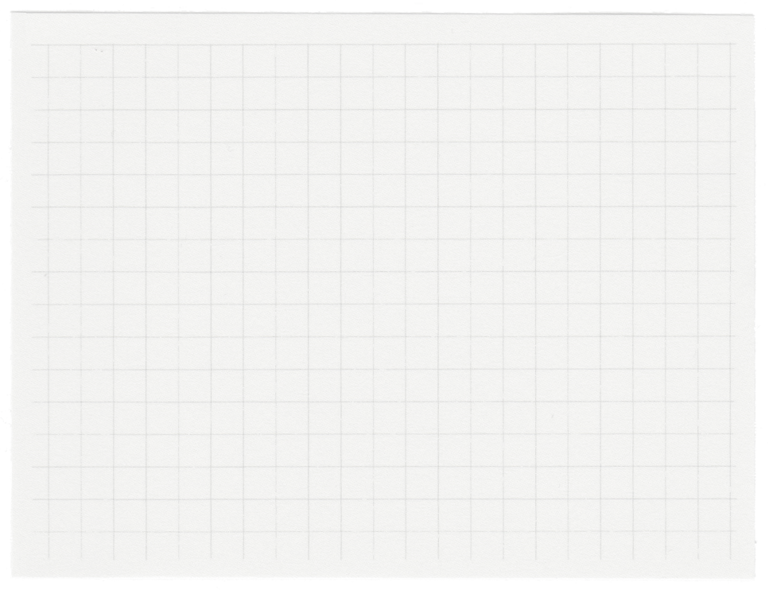













CI Project Proposal
Image segmentation by using genetic algorthims
MUHAMMAD GHULAM ABBAS 29417

Slide 2
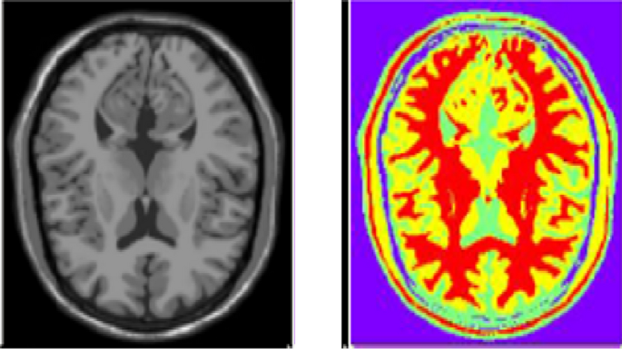
Image segmentation
i
Image Segmentation
Definition:
Image segmentation is the process of partitioning a digital image into multiple segments (regions or objects). The goal is to simplify and/or change the representation of an image into something more meaningful and easier to analyze.
How It Works:
Groups pixels in an image based on shared characteristics such as:
Color
Intensity
Texture
Assigns a label to each pixel, indicating which segment or object it belongs to
Key Applications:
Medical Imaging:
Example: Separating tumors from healthy tissue in X-ray or MRI scans.
It can also used biomedical image Recognition In a medical image:
Segmentation isolates a suspicious region (like a tumor).
Recognition classifies it as benign or malignant.
So, recognition often follows segmentation. Segmentation prepares the image so that recognition can happen more accurately.
I

Slide 3
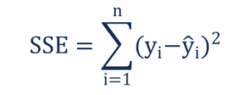
3.Objective Function
Objective Function: Sum of Squared Errors (SSE)
1.Partition the image into clusters (segments) where pixels in the same cluster are as similar as possible (e.g., in intensity, texture, or color).
2.For each candidate solution (particle), the fitness is calculated based on the distance of pixels to cluster centroids.
3 The objective is to minimize the sum of squared distances between pixels and their assigned cluster centroid:
Why PSO is Better:
Avoids Initial Centroid Issues: Unlike K-Means, which is sensitive to initial centroid placement, PSO uses a population-based approach to explore the solution space globally, reducing the risk of local optima.
.

Slide 4
4.Campartive Analysis
I plan to employ three evolutionary algorithm-based approaches for image segmentation to conduct a comparative Analysis. These approaches are:
Genetic Algorithm (GA)
Differential Evolution (DE)
Particle Swarm Optimization (PSO)
Ant Colony Optimization
Genetic Programming
Each algorithm will be evaluated based on the benchmarking algorithm mean shift and ground truth. The goal is to assess their performance and effectiveness in image segmentation tasks through a structured and fair comparison.
The idea is from this paper: Fatty Liver Level Recognition Using Particle Swarm Optimization (PSO) Image Segmentation and Analysis.
Link to the paper:
https://ieeexplore.ieee.org/document/9960108
DOI: 10.1109/ICCKE57176.2022.9960108

Slide 5
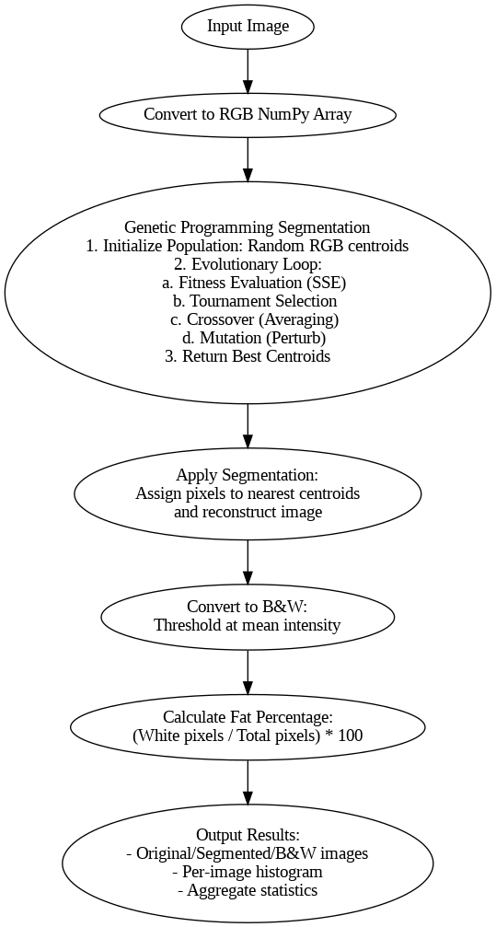
4.Genetic Programming

Slide 6
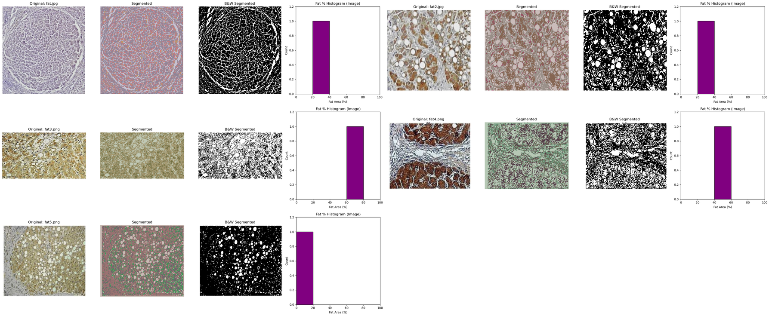
4.Genetic Programming Results

Slide 7
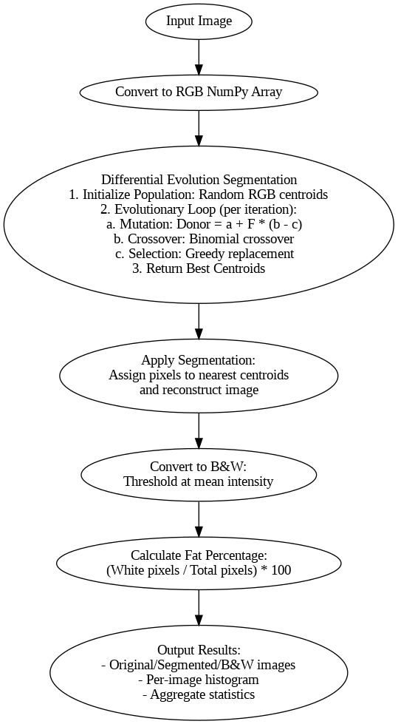
5.Differential Evolution

Slide 8
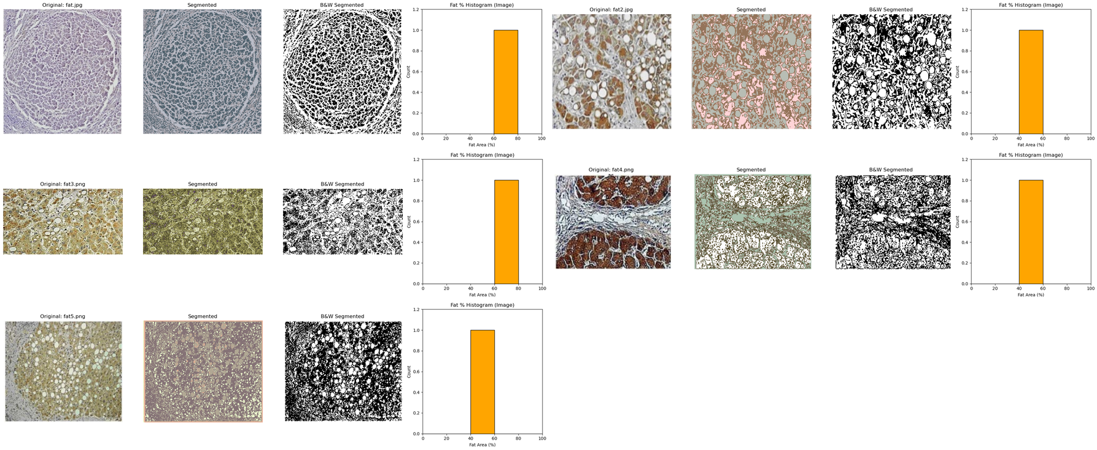
6.DE Results

Slide 9
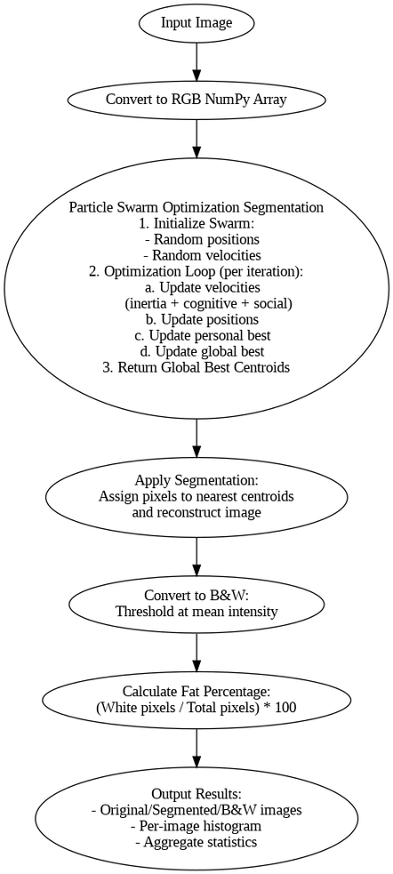
7.PSO

Slide 10
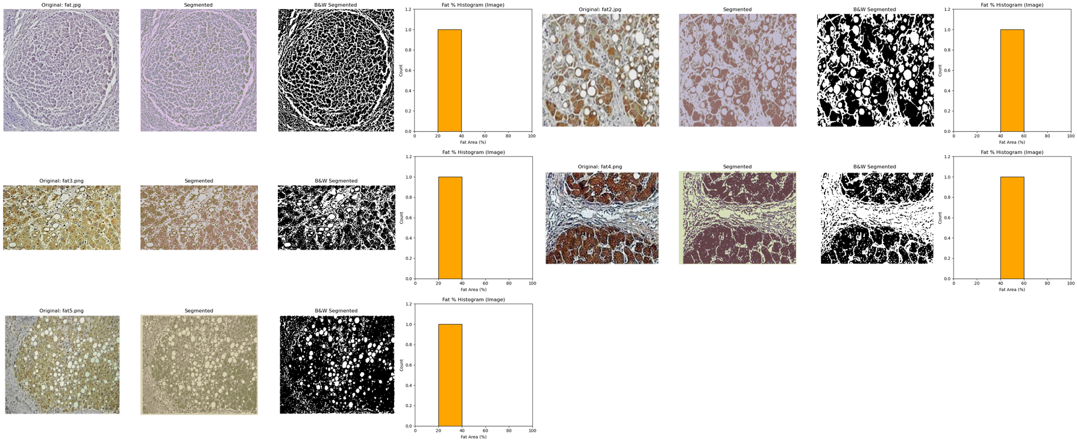
8..PSO Results

Slide 11
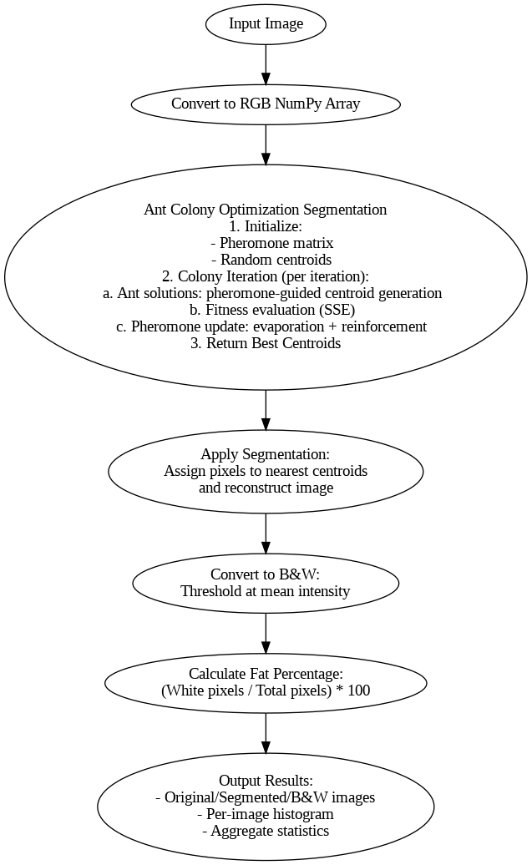
8.ACO

Slide 12
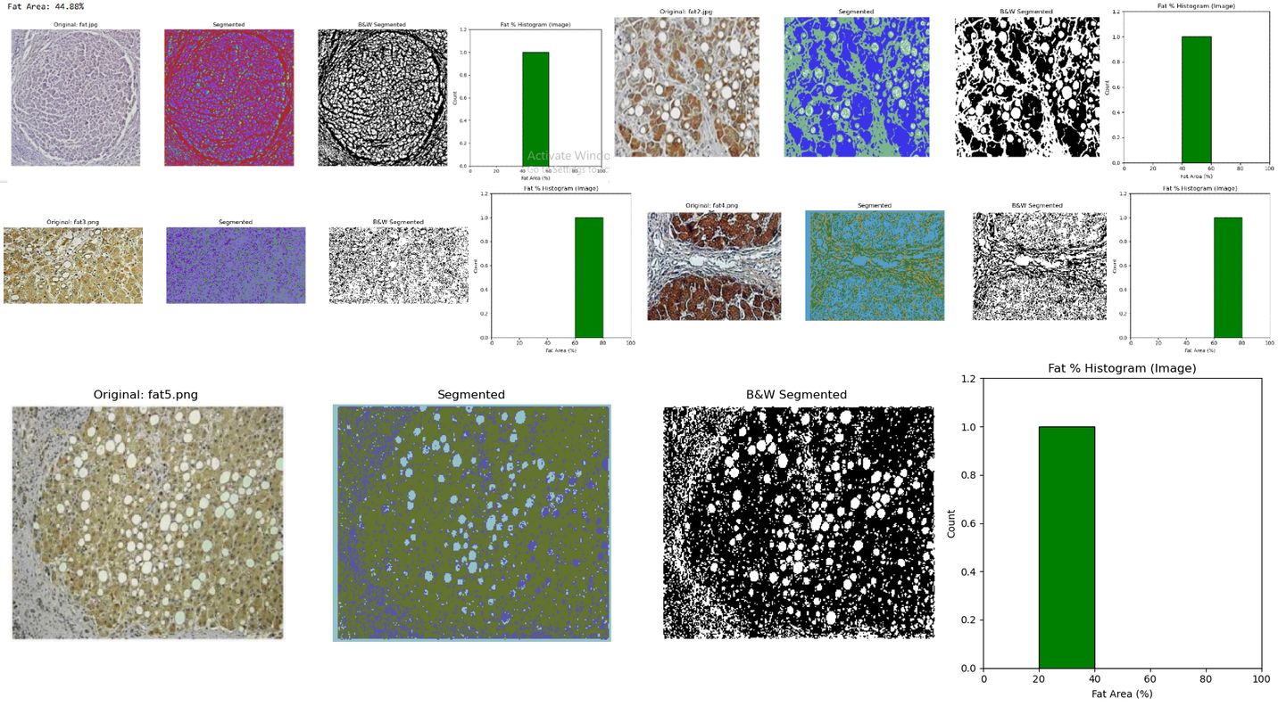
9..ACO Results

Slide 13
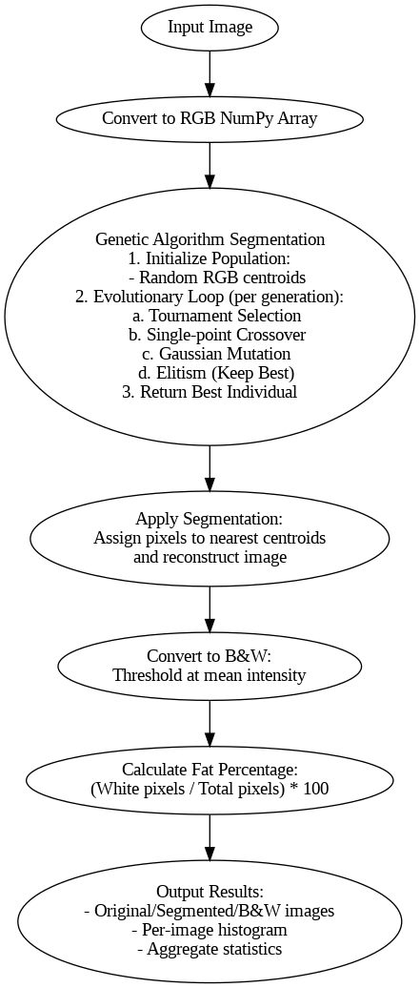
10.GA

Slide 14
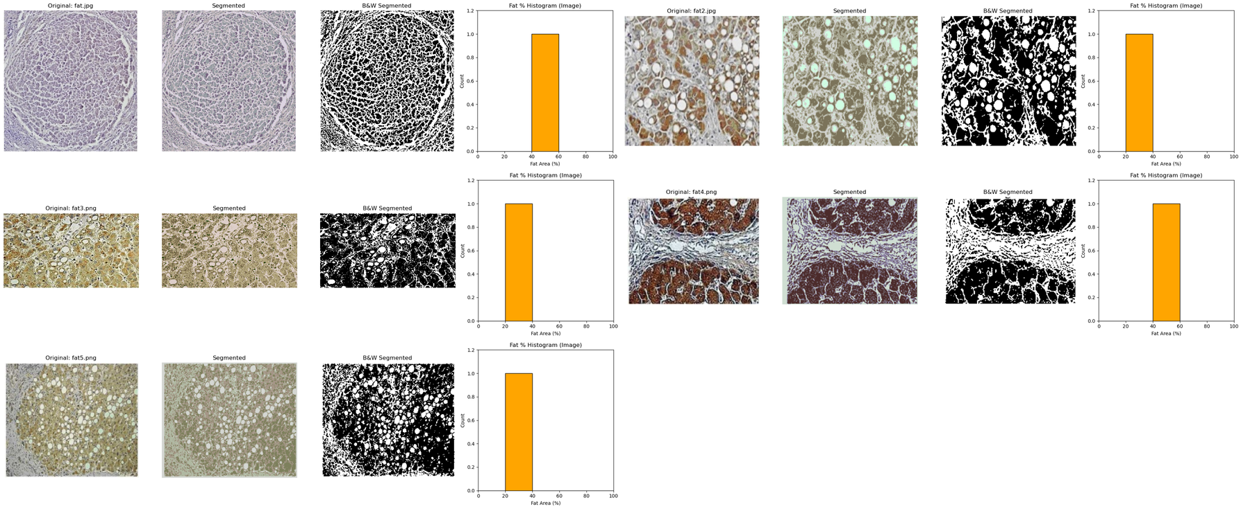
11. GA Results

Slide 15
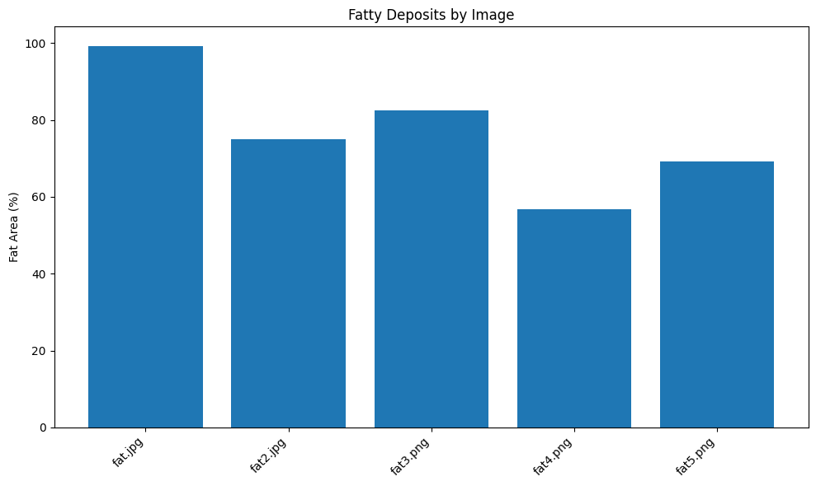
12.Results
I
Fat 1 has the highest deposit and fat 4
is lowest deposit

Slide 16
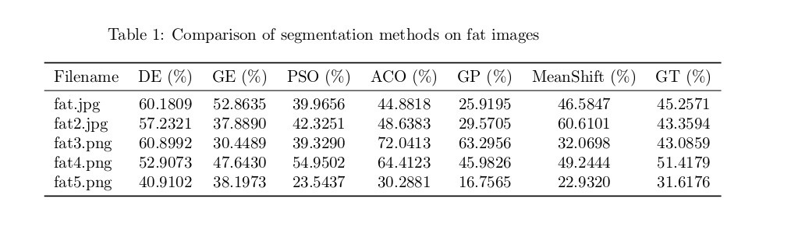
13.BEST ALGORTHIM
Algorithm | MAE vs MeanShift (%) | MAE vs GT (%)
----------|----------------------|--------------
DE | 13.49 | 11.48
GE | 9.50 | 7.01
PSO | 7.70 | 4.34
ACO | 15.23 | 9.79
GP | 18.47 | 14.73
Key Observations:
- PSO performed best against both benchmarks (7.70% vs MeanShift, 4.34% vs GT).
- GP had the worst performance (18.47% vs MeanShift, 14.73% vs GT).
- GE ranked second against GT (7.01% MAE).

Slide 17
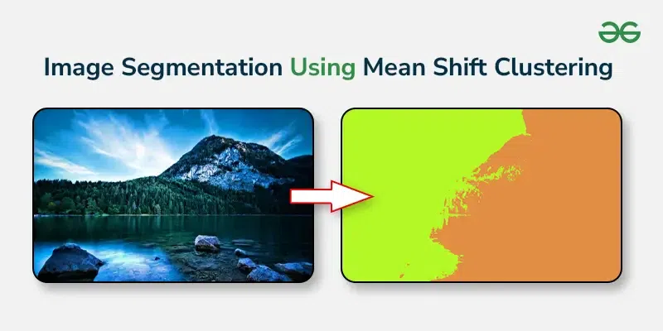
Why Use MeanShift as a Benchmark?
MeanShift is a non-parametric, unsupervised clustering algorithm widely used for image segmentation.
It does not require prior assumptions about data distribution, making it a neutral benchmark for comparison.

Slide 18
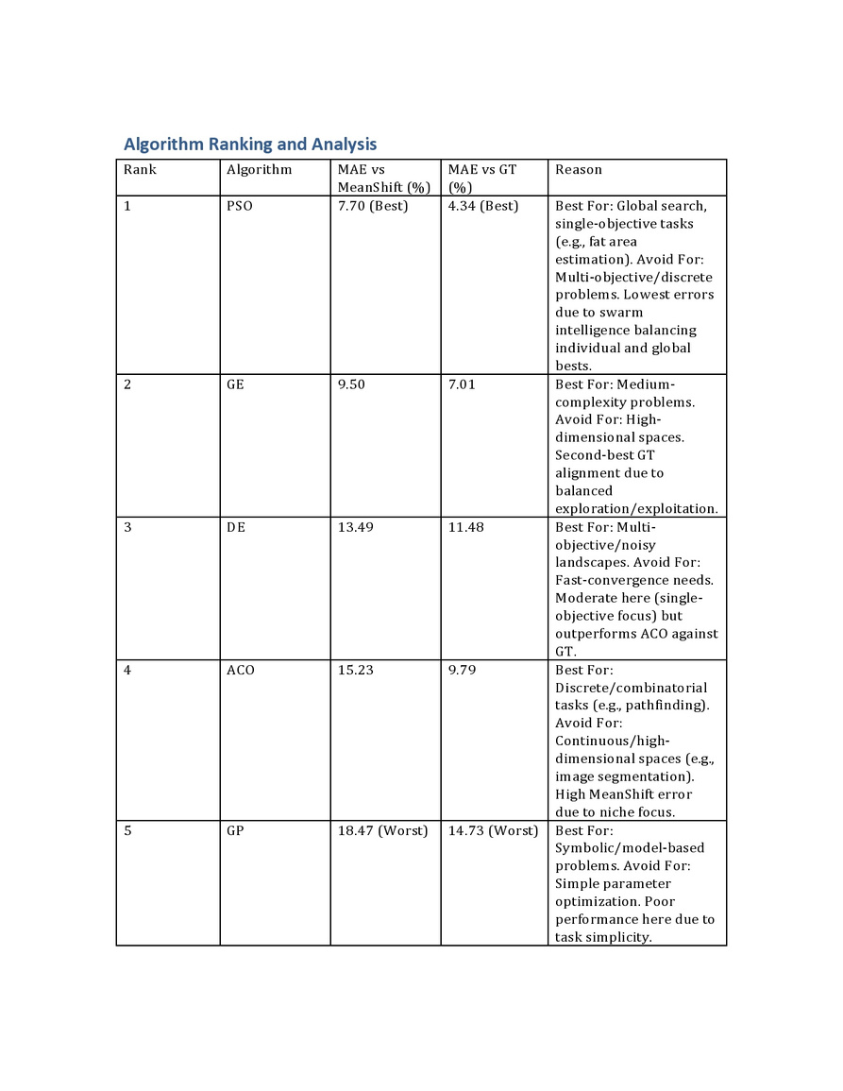
Finding

Slide 19
CONCLUSION
This study evaluates heuristic algorithms (PSO, GE, DE, ACO, GP) for fat area estimation against MeanShift (algorithmic benchmark) and Ground Truth (GT), revealing that Particle Swarm Optimization (PSO) achieves superior accuracy, with the lowest Mean Absolute Error (MAE: 7.70% vs MeanShift, 4.34% vs GT), attributed to its global search efficacy in continuous, single-objective optimization tasks like pixel-based segmentation. Genetic Algorithm (GE) ranked second (MAE: 9.50% vs MeanShift, 7.01% vs GT), balancing exploration-exploitation, while Differential Evolution (DE) showed moderate performance (MAE: 13.49% vs MeanShift, 11.48% vs GT), better suited for multi-objective scenarios. Ant Colony Optimization (ACO) and Genetic Programming (GP) underperformed due to incompatibility with continuous image spaces and oversimplified parameter tuning, respectively. The results validate MeanShift as a stable, texture-driven benchmark for segmentation tasks and highlight PSO’s robustness in medical imaging applications. Future work should explore hybrid models or multi-objective DE configurations to further optimize accuracy-computation tradeoffs.

Slide 20
Thank you very much!

